Slide 1
Project 2
Jessica Hills
Rebecca Mih

Slide 2
The Interactive Research Notebook
Our project is a combination of:
Web Scraping and Leaflet or Plotly
A dashboard page with multiple charts all updating from the same data
And includes at least one JS library that we did not cover. We used Chart.js
Has at least 100 records. We had over 800 records.
Has User-driven interaction (e.g. menus, dropdowns, textboxes, etc.). Yes
Includes at least three views. Yes

Slide 3


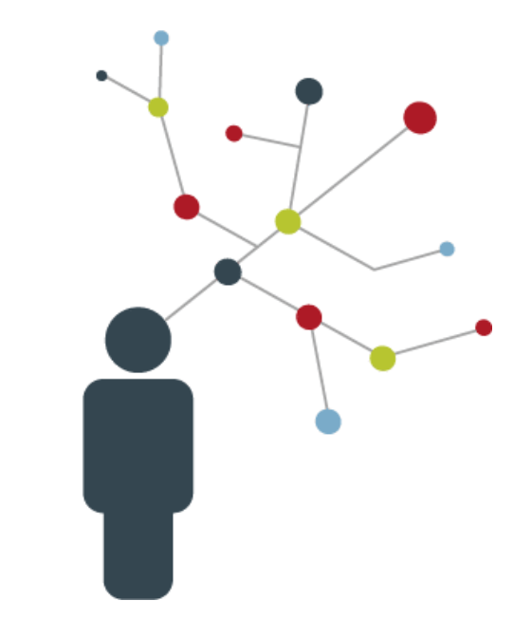
Researchers spend 100s of hours gathering, categorizing and storing publications and reference material
We aim to reduce the busywork related to managing research information

Slide 4
Process and Tools
Acquisition of publication information: Beautiful Soup on Google Scholar into CSVs
Author list
Title
Abstract
Citations
Date of Publication
Data Cleaning : Python Pandas, NumPy, Re into CSVs
Removing non-ASCII characters
Using Regex to establish tags for each publication
Creating appropriate labelling
Creating the Dashboard - Data Analysis and Visualization
HTML / Javascript /Bootstrap
Flask
Plotly
D3.js
Chart.js

Slide 5
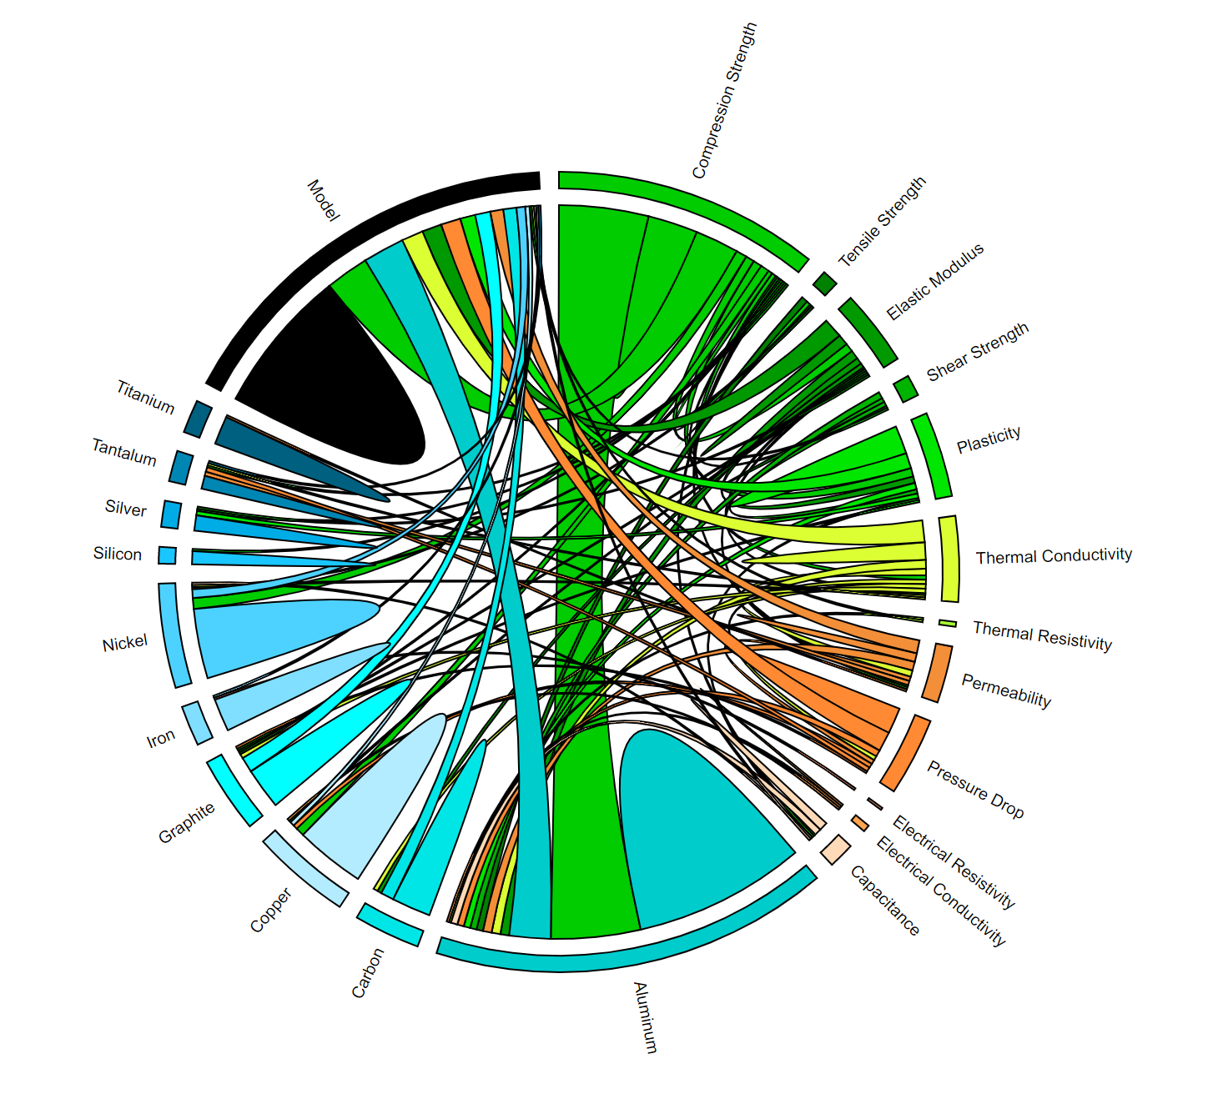
Documents analysis
The chord diagram is useful to visualize the contents of documents.
In this case, academic publications for metal foams are classified by:
the materials used to make the foam (Aluminum, Copper, etc), and
The materials properties (e.g. strength, elasticity, conductivity), that were tested by the authors.
In this way, it's easy to what materials and properties researchers have studied the most, by the relative size of the arcs and chords in the diagram.

Slide 6
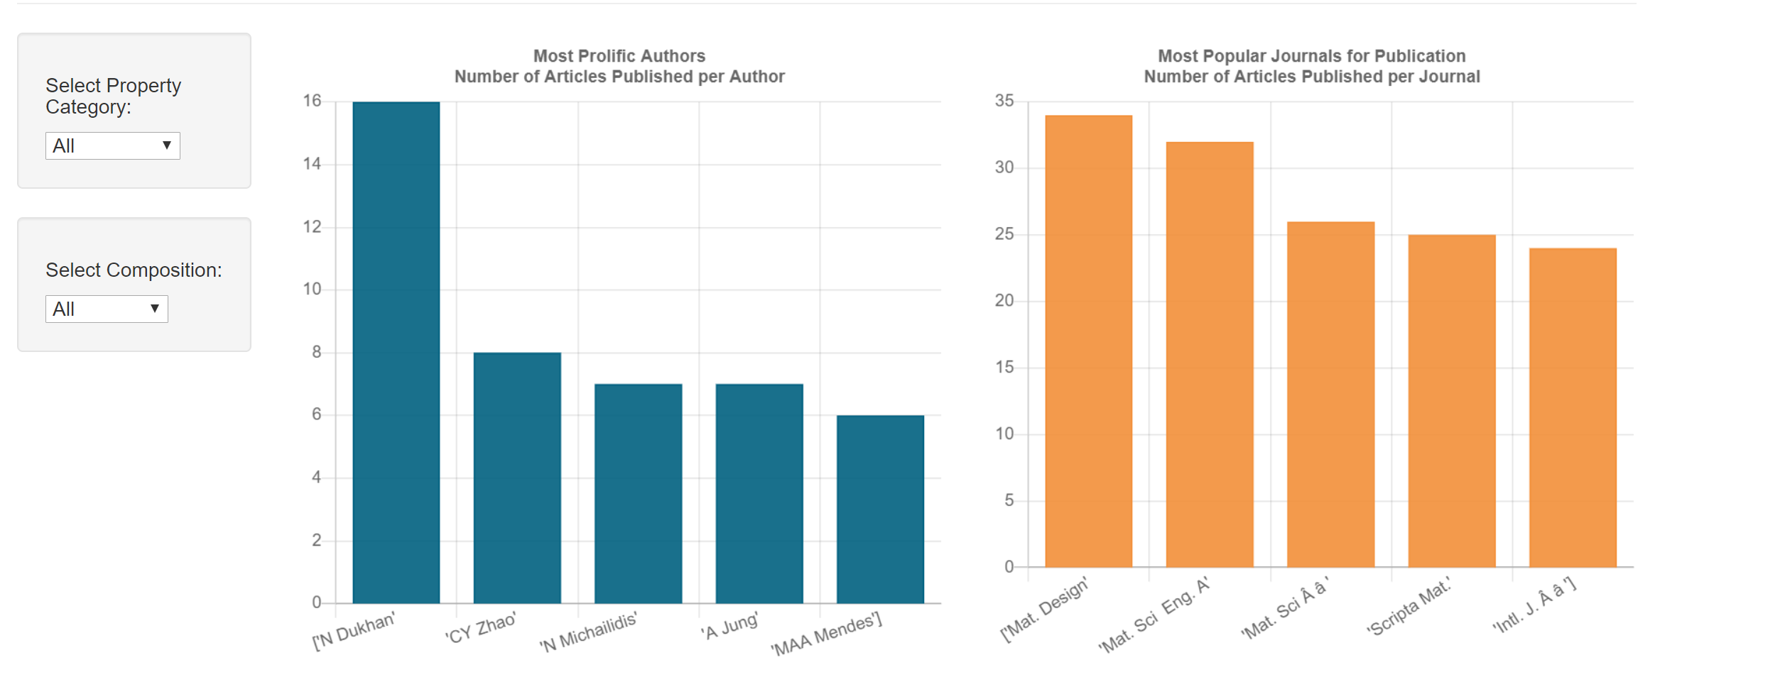
Social Analysis
Analysis of the most prolific authors, and the most popular journals, by material and properties, is helpful for identifying potential collaborators and their areas of expertise.

Slide 7
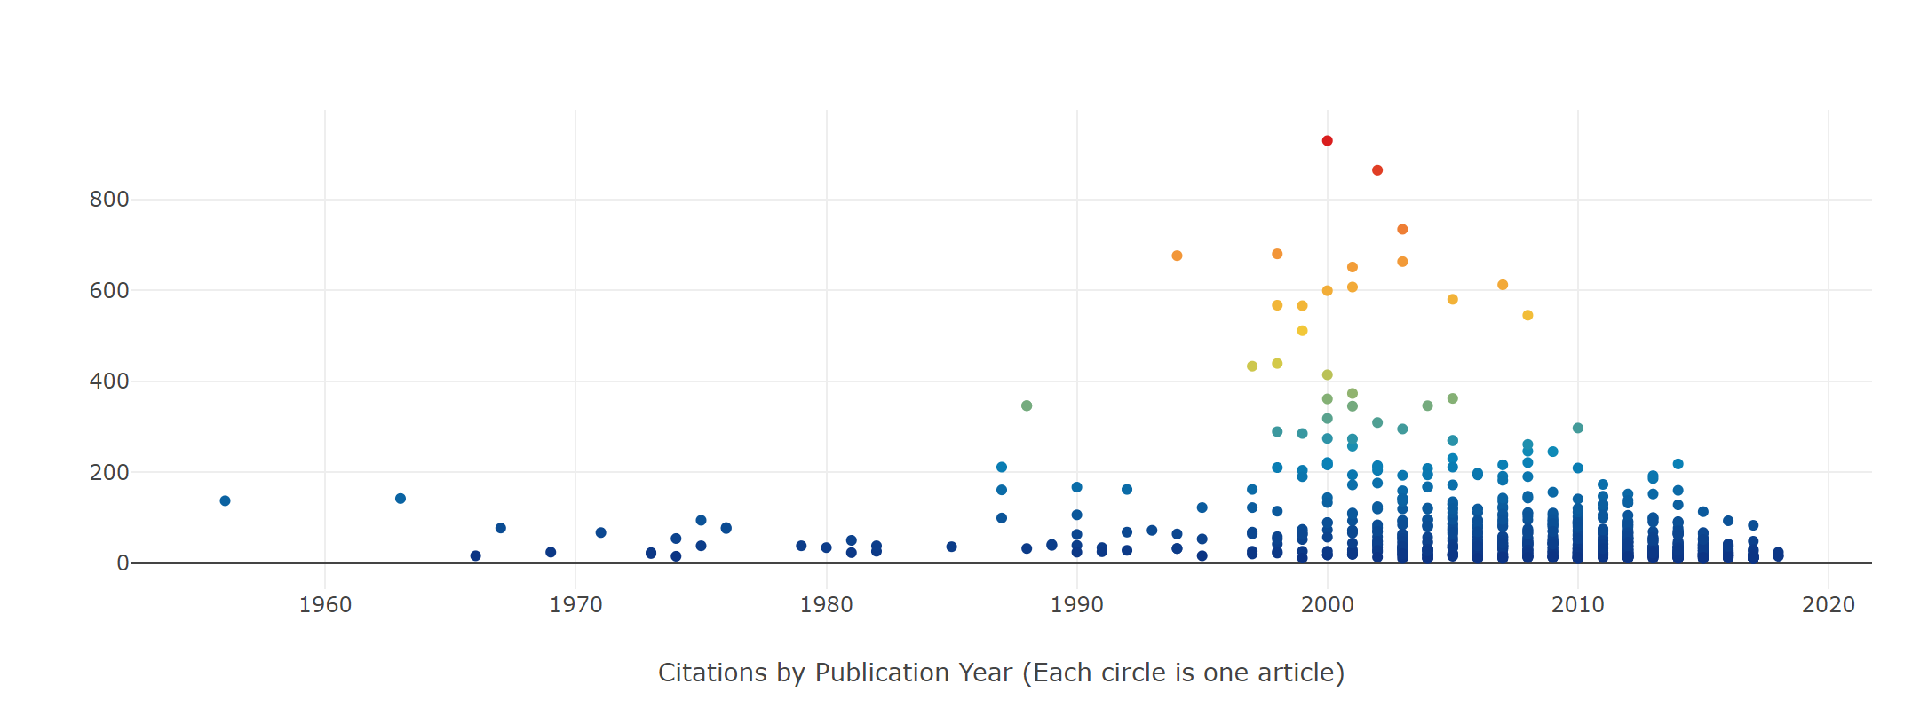
Competitive Analysis
The Publication Timeline shows evolution of research interest in metal foams, over time. The number of citations by others indicates the importance of the articles content. Ground-breaking articles may have hundreds or even thousands of citations.
# of citations

